Slide 1
The PIGs Full Monty- A floor show of minimal separators
Gerard Jennhwa Chang, Antonius J. J. Kloks, Jiping Liu, Ross M. McConnell, and Sheng-Lung Peng
Symposium on Theoretical Aspects of Computer Science 2005
Presented by Chien-Fu Tung

Slide 2
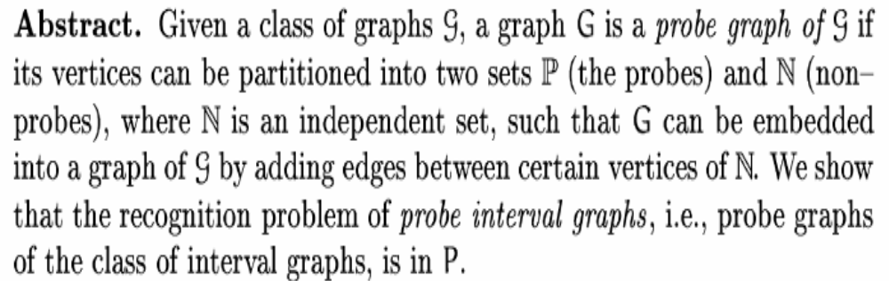
Abstract

Slide 3
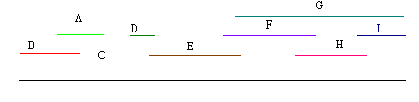
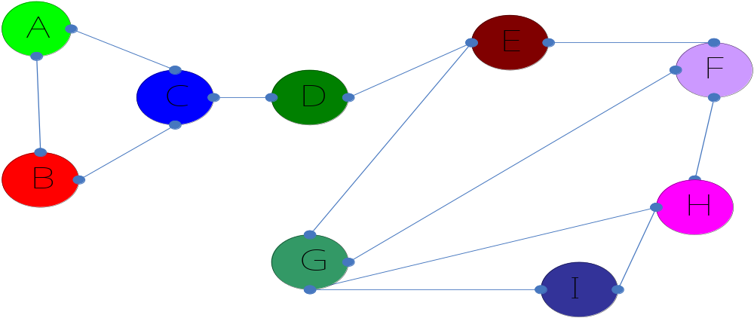
Interval Graph

Slide 4
Probe Interval Graph
Definition :Let V be a finite set of intervals of a real line, and P be a subset of V . Then a probe graph G(V,P,E) whose vertex set is V , whose probe set is P, and whose edge set is E, will be called a probe interval graph, if its vertex set is E = {(v_{i}, v_{j}) | v_{i} ∩ v_{j} = ∅ and v_{i} ∈ P or v_{j} ∈ P}
Probe
Non-probe

Slide 5
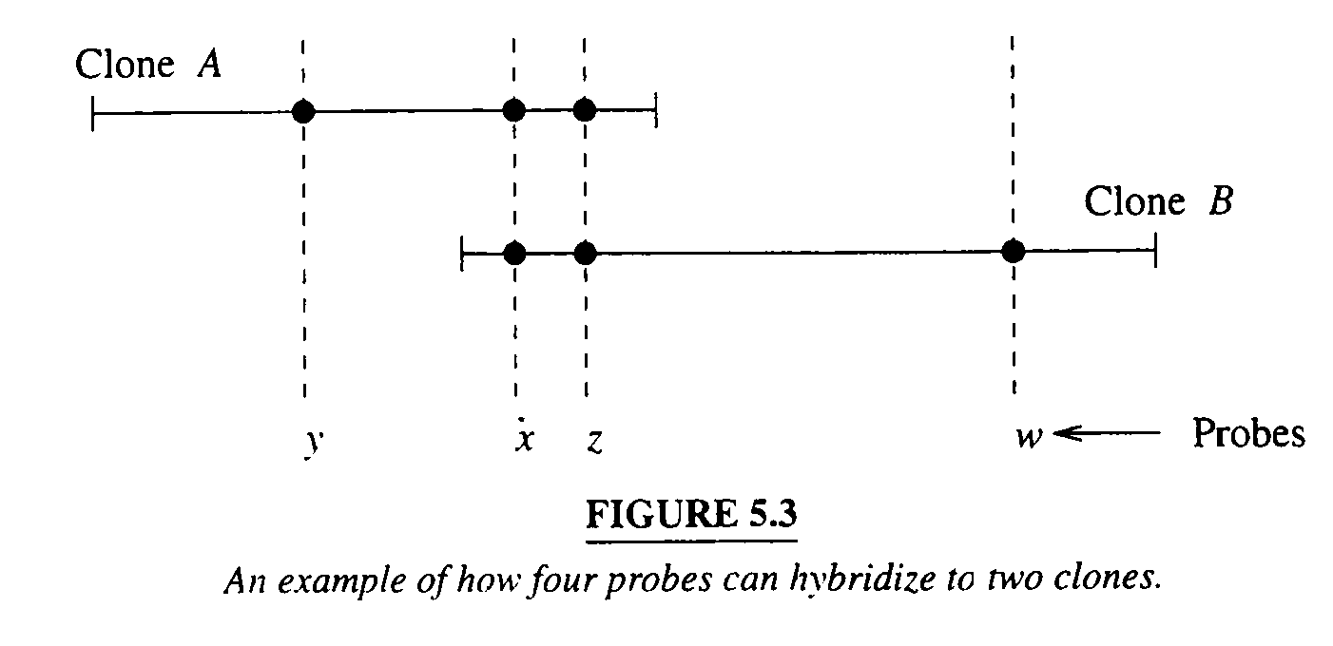
Physical Mapping
Given a (0,1) matrix of probes versus clones, to reconstruct the relative places of clones or probes.
NP-complete problem

Slide 6
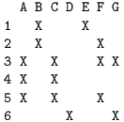
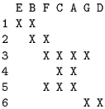
Consecutive Ones Problem
⇒

Slide 7
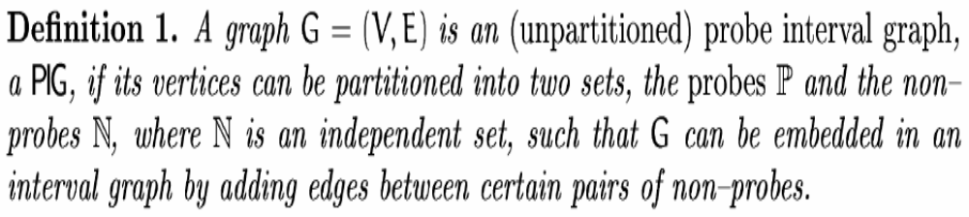
Preliminaries(1)

Slide 8
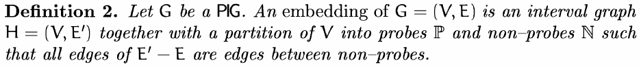
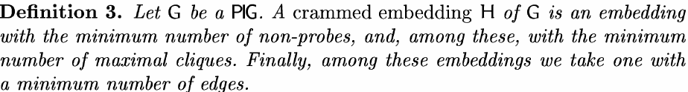
Preliminaries(2)
Embedding : An embedding G1 = (V1,E1) of G2 = (V2,E2) is an injection from V2 to V1 such that every edge in E2 corresponds to a path (disjoint from all other such paths) in G1

Slide 9
Preliminaries(3)
A graph is an interval graph if and only if the maximal cliques of G can be linearly ordered such that for each vertex x, the maximal cliques that contain x occur consecutively. Such an ordering of the maximal cliques is called a consecutive clique arrangement
Let D=[D₁, D₂,…, D_{t}] be a consecutive clique arrangement of a crammed embedding H. The objective of this paper is to find such a sequence of subsets.

Slide 10
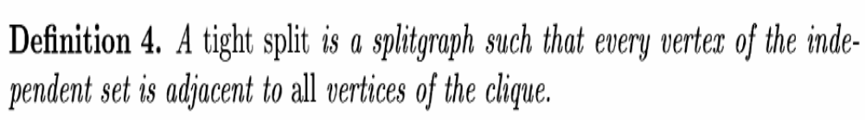
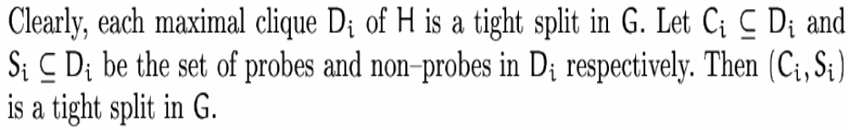
Preliminaries(4)

Slide 11
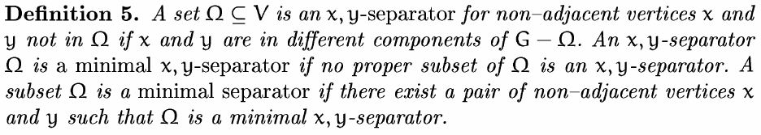
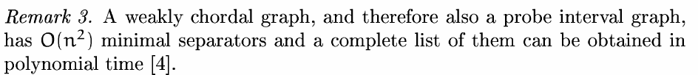
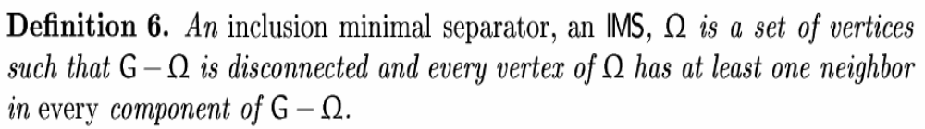
Minimal Separator

Slide 12
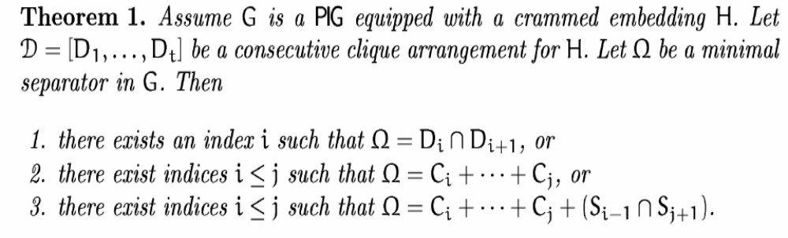
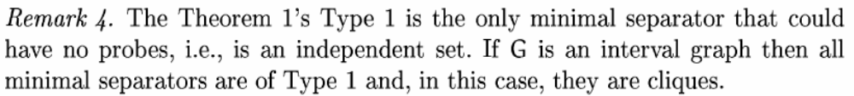
Properties of Minimal Separator

Slide 13
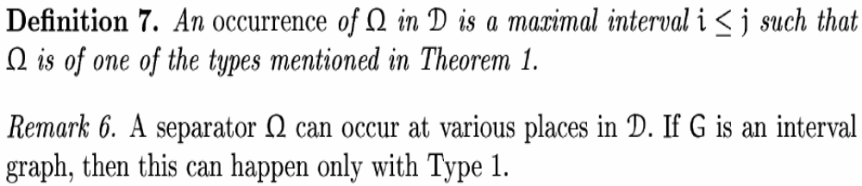
Arrangement of an IMS and its components(1)
Assume G is a PIG equipped with a crammed embedding H and let D be a consecutive clique arrangement for H. Let Ω be an IMS of G.

Slide 14
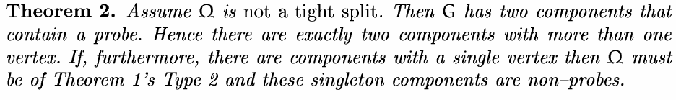
Arrangement of an IMS and its components(2)

Slide 15
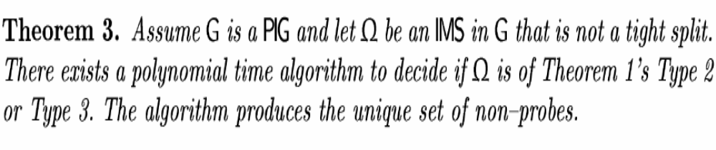
Arrangement of an IMS and its components(3)

Slide 16
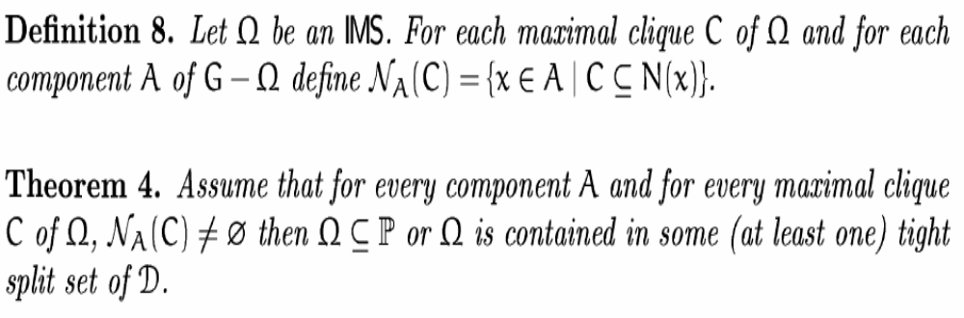
Thinning to tight splits for large components

Slide 17
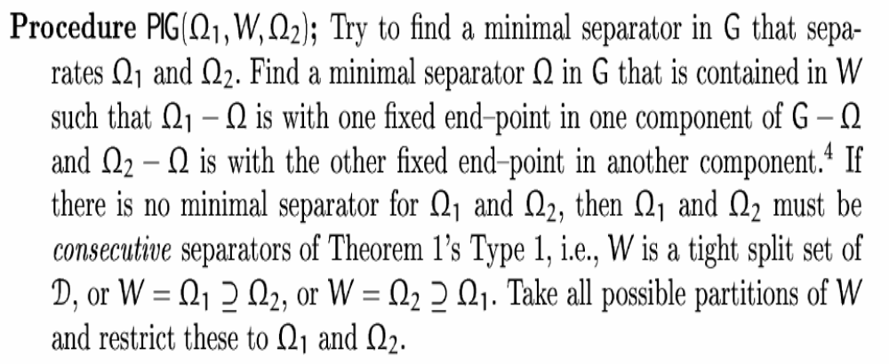
Recognitions of PIGs(1)

Slide 18
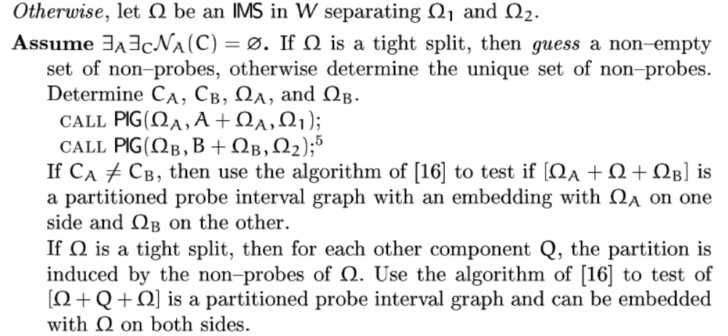
Recognitions of PIGs(2)

Slide 19
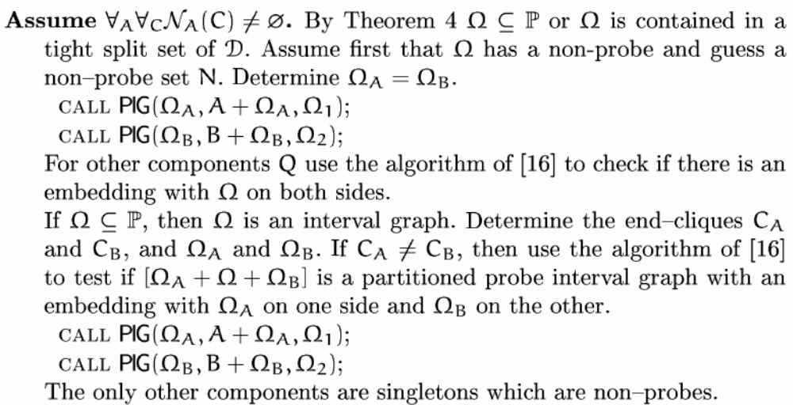
Recognitions of PIGs(3)

Slide 20
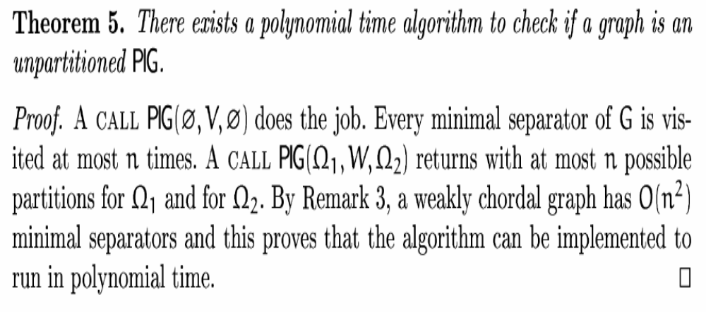
Conclusion

